Slide 1

Data Analytics Final project Predict Future Sales
Group members:
Krisha Shah
Bhavya shah

Slide 2
contributions
Bhavya Shah:
Reading data, Data visualization graphs, Data Cleaning, Modelling data, Visualizing important features, Manipulating submission file.
Krisha Shah:
Reading data, Data Visualization word clouds, Eliminating Outliers, Making prediction, Calculating RSME, Storing submission in CSV.

Slide 3
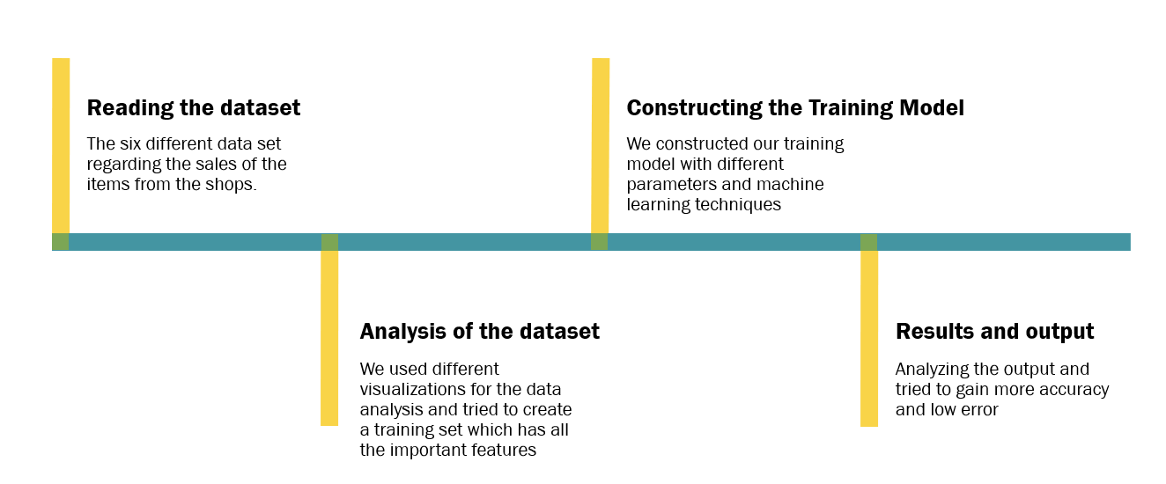
Proposed methodology

Slide 4
Problem Statement
In this project we will work with a challenging time-series dataset consisting of daily sales data, kindly provided by one of the largest Russian software firms - 1C Company.
We are provided with daily historical sales data. The task is to forecast the total amount of products sold in every shop for the test set.

Slide 5
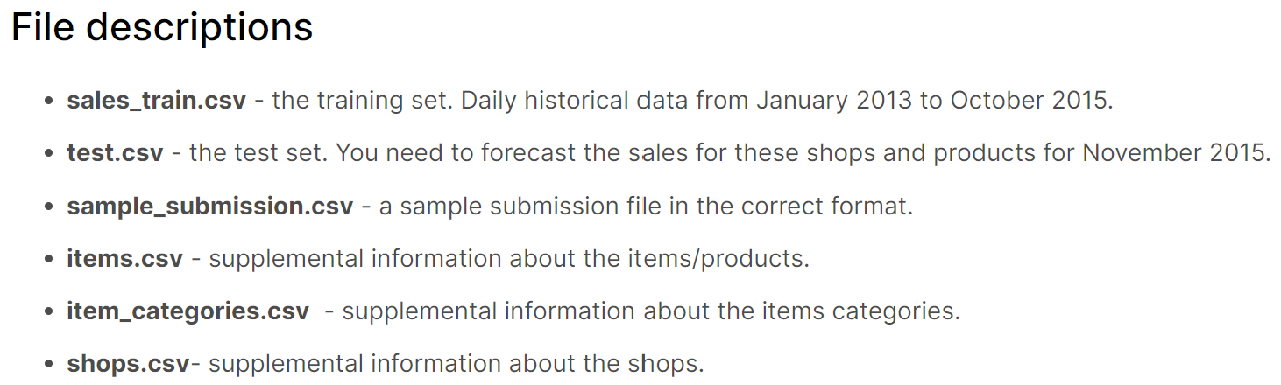
DataSET used
Below shown is the description of all 6 datasets given.

Slide 6
Reading the data
Here we are using read_csv by installing the readr Package for reading large csv files which could not be loaded with read.csv. Using read_csv in terms of speed is faster. Also, this function adds some nice user-oriented features.
training_data = pd.read_csv("sales_train.csv",parse_dates = ['date'], infer_datetime_format = True, dayfirst = True)
test = pd.read_csv("test.csv")
items_data = pd.read_csv("items.csv")
shops_data = pd.read_csv("shops.csv")
item_categories = pd.read_csv("item_categories.csv")
sample_submission = pd.read_csv("sample_submission.csv")

Slide 7
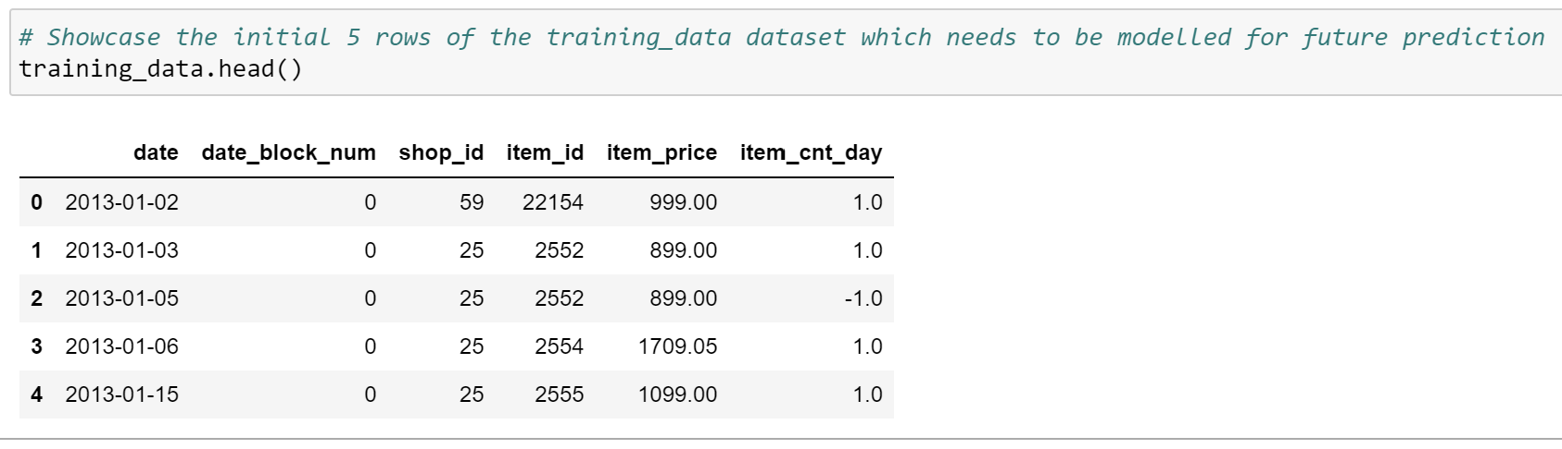
Sales_train dataset

Slide 8
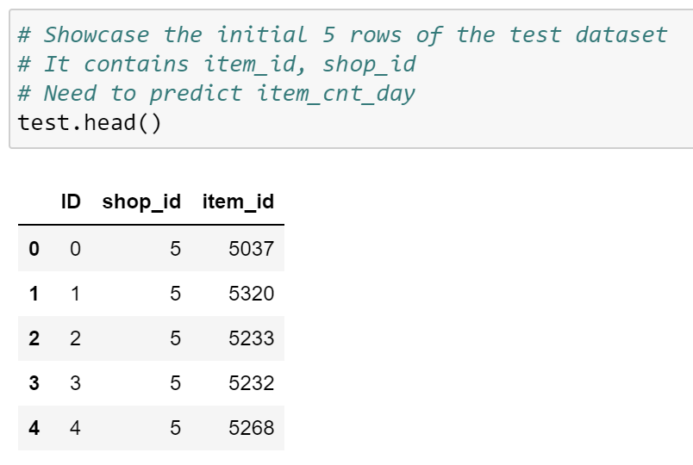
Test dataset

Slide 9
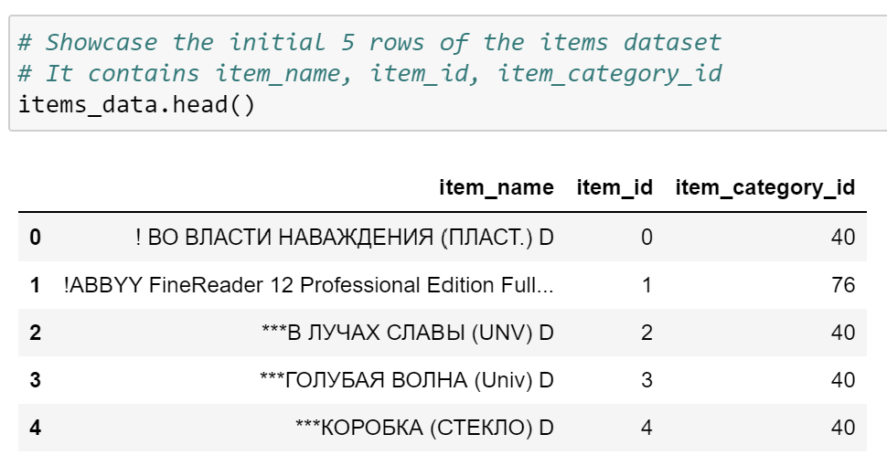
Items dataset

Slide 10
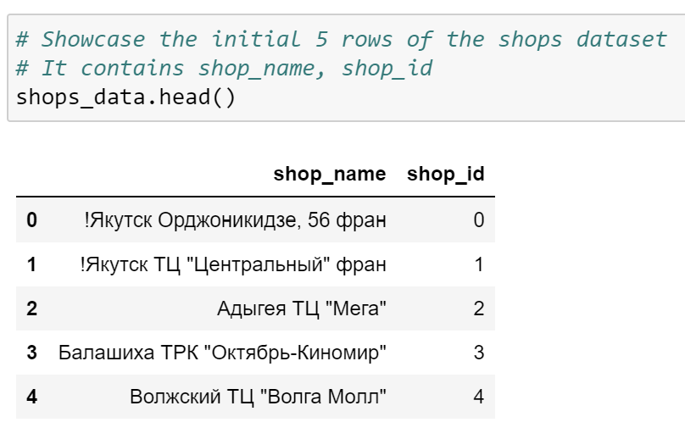
Shops dataset

Slide 11
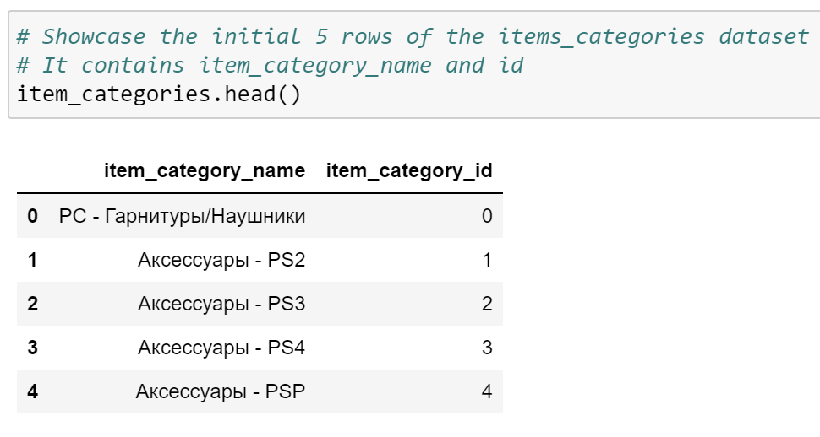
Item categories dataset

Slide 12
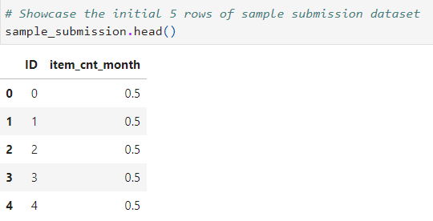
Sample submission dataset

Slide 13
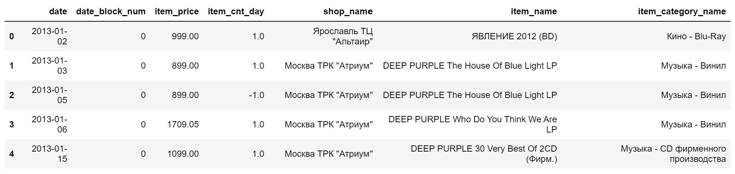
Merging datasets
Merging all the files with common parameters as shop_id, item_id, item_category_id

Slide 14
Tools used
Development Tool
Jupyter Notebook
Back-end to construct prediction model
sklearn
Xgboost

Slide 15
Tools used
Libraries used for visualization
seaborn
matplotlib
plotly
scipy
wordcloud

Slide 16
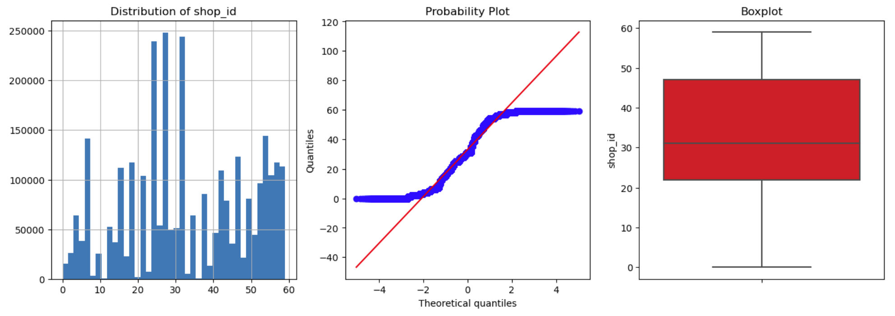
Data Analysis
We explored the distribution of the daily sales data using Barplot, Probability plot and Box plot.

Slide 17
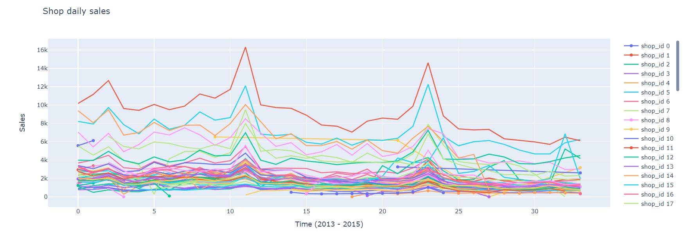
Data ANALYSIS
We explored the daily sales of all the shops for the time span of 2 years with the help of line graph.

Slide 18
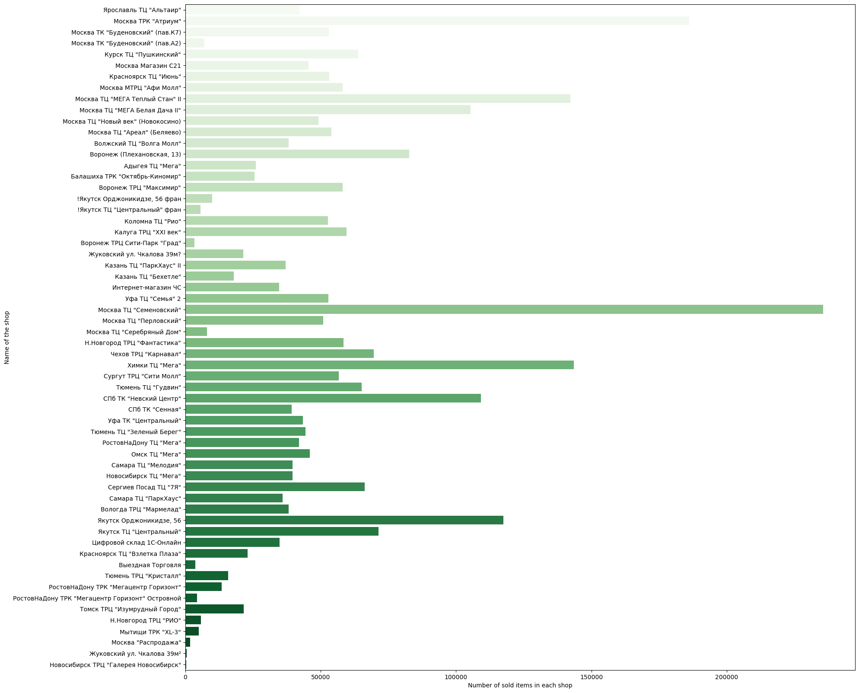
Data ANALYSIS
Frequency of sales among shops

Slide 19
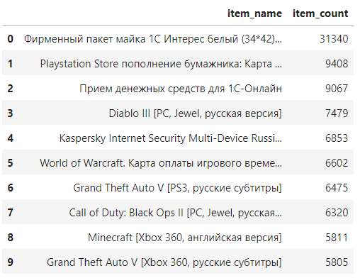
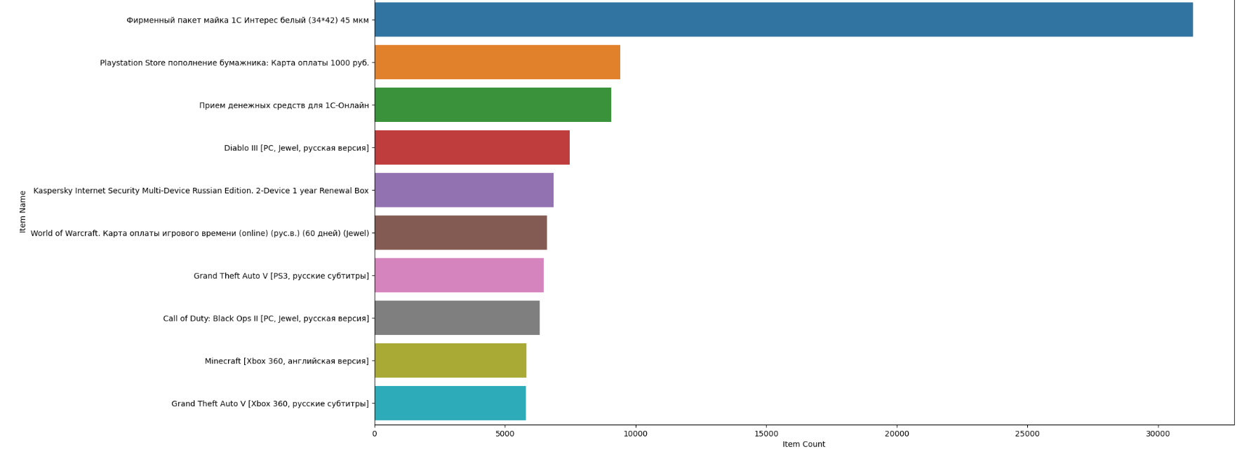
Data analysis
The top 10 best selling items

Slide 20
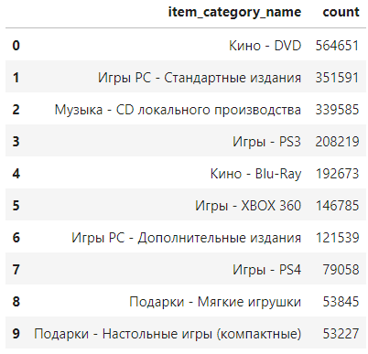
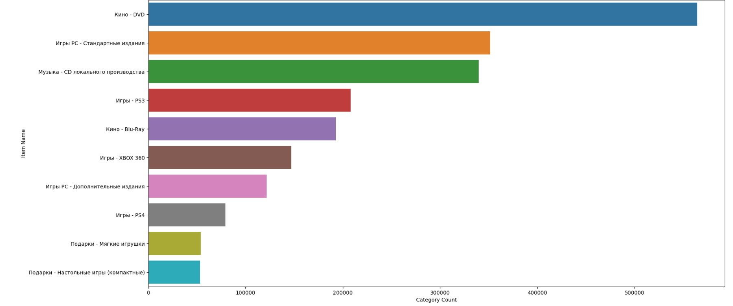
Data analysis
The top 10 best selling categories

Slide 21

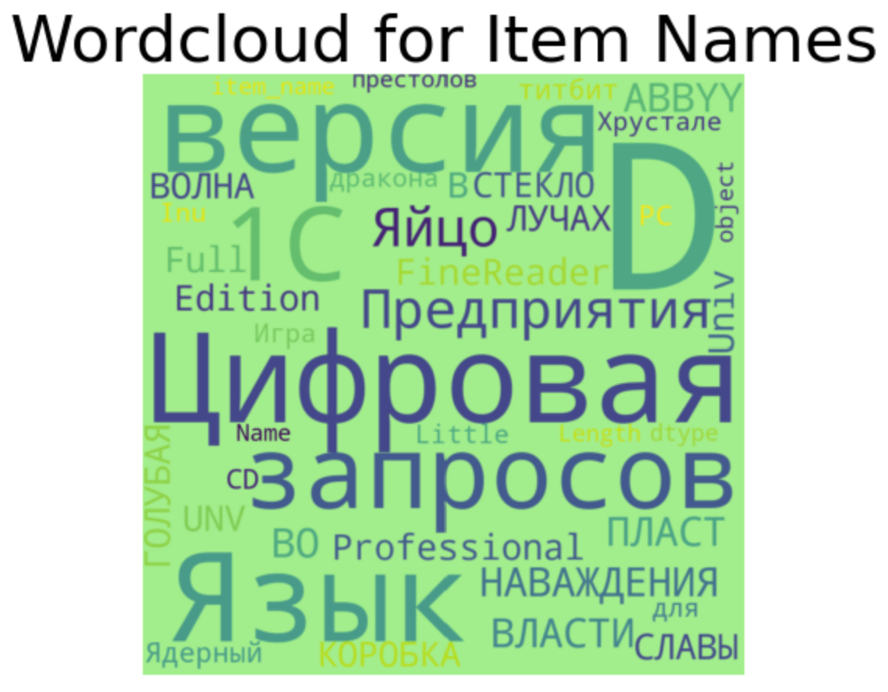
Data analysis

Slide 22
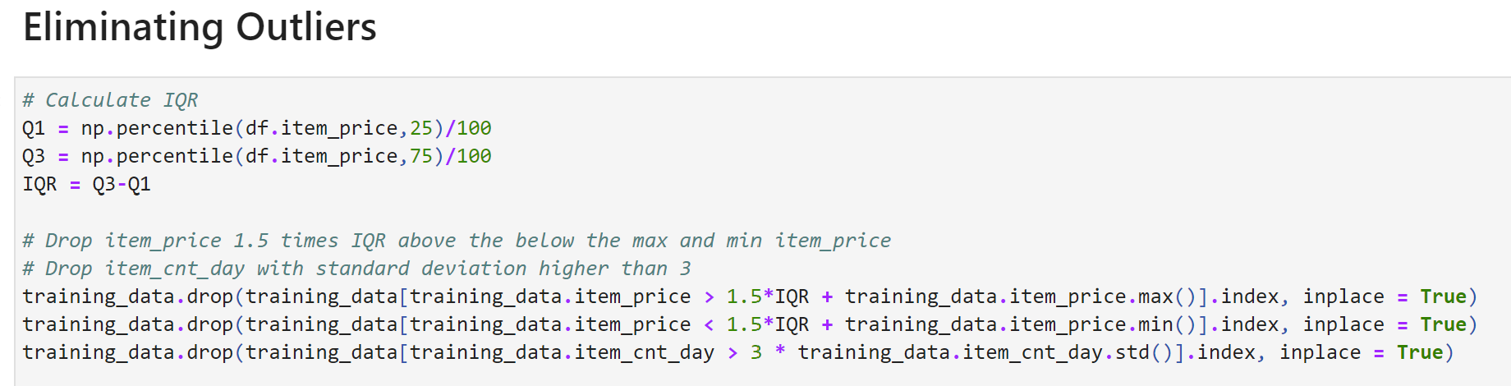
Data cleaning
Step-1: Eliminating the Outliers
Outliers are those data points that are significantly different from the rest of the dataset.
We tried to remove the outliers using IQR(Interquartile Range) and Standard Deviation
Initially we calculated the IQR, using the formula: IQR = Q3-Q1
Then from the training dataset we dropped the item prices which were 1.5 times IQR above the below the max and min item prices.
We also dropped the item’s day count tuples whose standard deviation was more then 3.

Slide 23
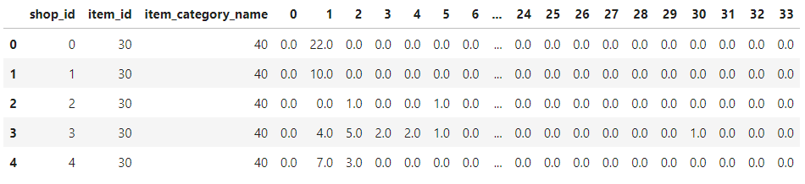
Data cleaning
Step-2: Removing the negative values from the tuples and setting it to zero.
Step-3: Grouping the data
We created a pivot table of the training dataset and grouped the data based on shop id and item id.
Step 4: Resetting all the indexes and setting the datatype as “String” of all the tuples.
Step 5: Perform Label Encoding to the dataset
Step 6: Rearranging the columns

Slide 24
Prediction model
We predicted the item sales using two different approaches and measured the performance using RMSE approach
Here we will be using root mean square error (RMSE).
The root mean square (RMS) is the square root of the mean square, which is the arithmetic mean of the squares of a group of values. RMS is also called a quadratic mean and is a special case of the generalized mean whose exponent is 2.

Slide 25
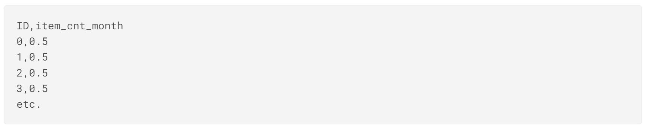
Evaluation
Submissions are evaluated by root mean squared error (RMSE). True target values are clipped into [0,20] range.
For each id in the test set, you must predict a total number of sales. The file should contain a header and have the following format:

Slide 26
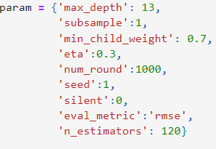
Model – 1 : xgb Approach
Dmatrix is an internal data structure that is used by XGBoost which is optimized for both memory efficiency and training speed.
We generated Dmatrix for training the model. We divided the dataset
We used various parameters and assigned values for accurate results.

Slide 27

Model – 1 : xgb Approach
We trained the model using the Dmatrix and the specified parameters.
We predicted by putting the first 32 columns as input and the last 33 column as output just as we did in Dmatrix.
We predicted using the trained model and calculated the RMSE score.
For this particular dataset and model, the score was quite low i.e 0.43

Slide 28
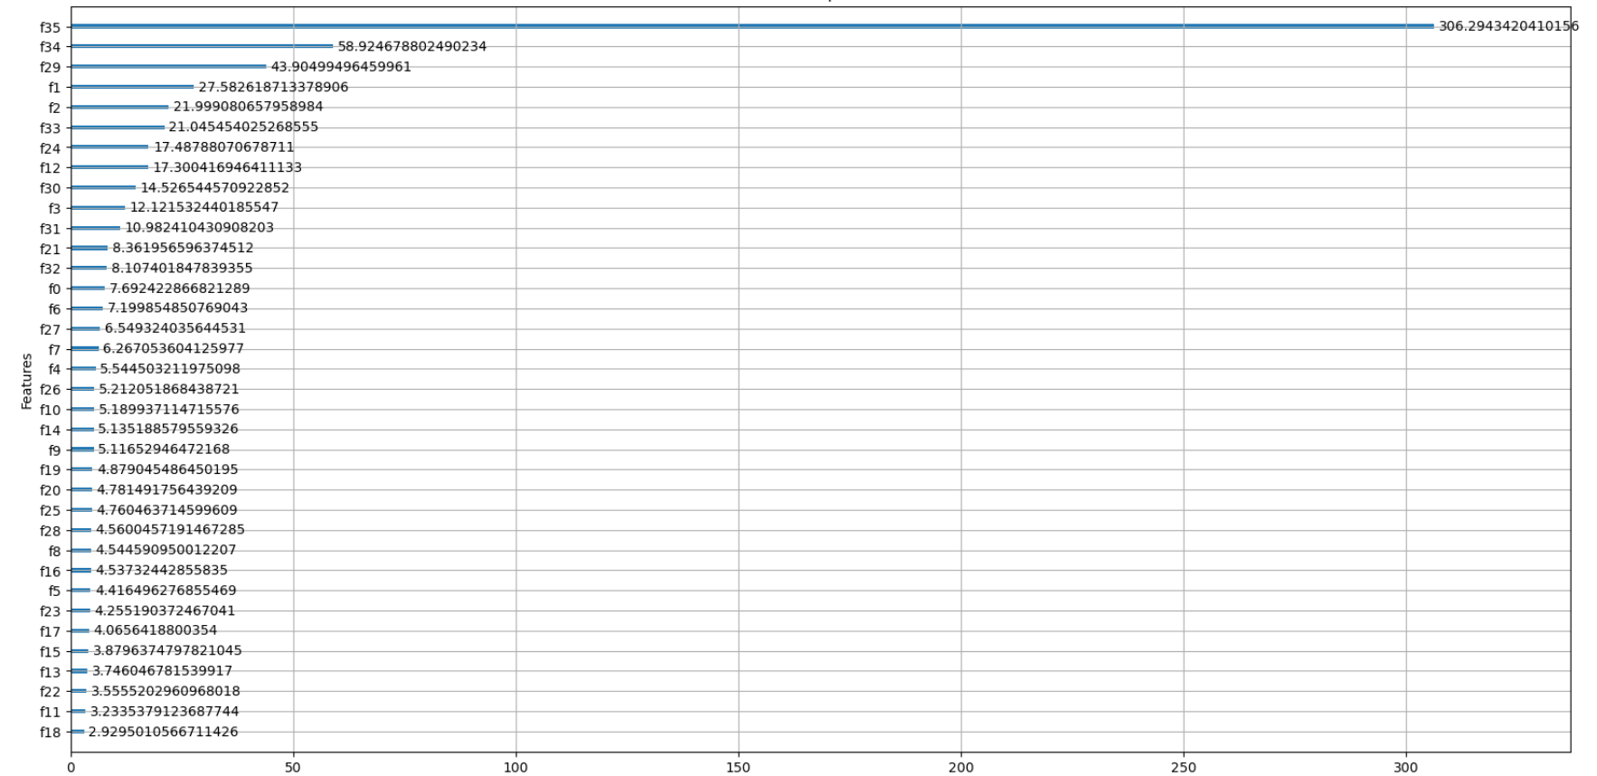
Model -1 : xgb approach
As this is a machine learning approach, we also explored the most important features extracted.

Slide 29
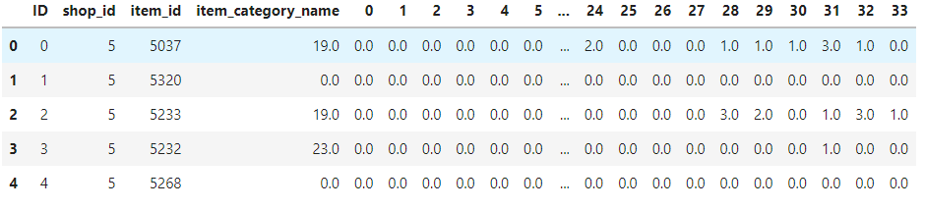
Model -1 : xgb approach
We tested the model using the test dataset. Just like the training dataset, we cleaned the test data and rearranged the columns.

Slide 30
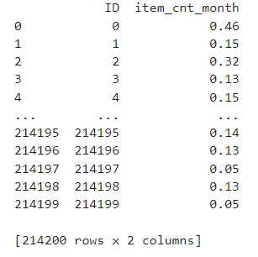
Model -1 : xgb approach
We predicted the sales by making the Dmatrix of the testing dataset.
After predicting the sales, we saved the output in submissions using the item id and the its predicted sales.

Slide 31
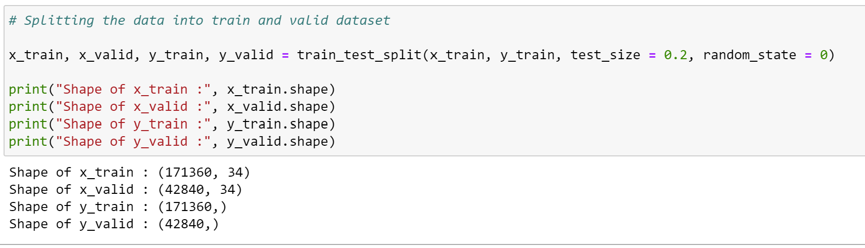
Model -2 : LGBM Regressor
LGBMRegressor is a general purpose script for model training using LightGBM. It contains: Functions to preprocess a data file into the necessary train and test Datasets for LightGBM
We generated LGBM regressor for training the model. We divided the dataset into training and test dataset.

Slide 32
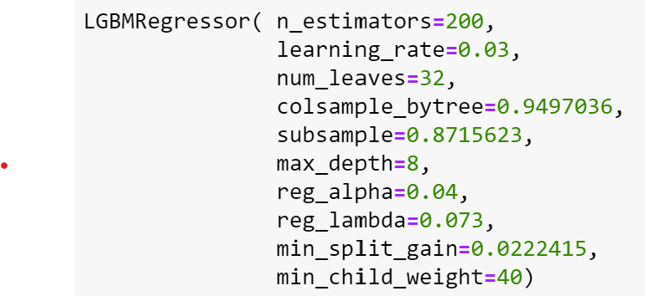
Model -2 : LGBM Regressor
We used various parameters and assigned values for accurate results.

Slide 33
parameters
n_estimators (int, optional (default=100)) – Number of boosted trees to fit.
learning_rate (float, optional (default=0.1)) – Boosting learning rate. You can use callbacks parameter of fit method to shrink/adapt learning rate in training using reset_parameter callback. Note, that this will ignore the learning_rate argument in training.
num_leaves (int, optional (default=31)) – Maximum tree leaves for base learners.
colsample_bytree (float, optional (default=1.)) – Subsample ratio of columns when constructing each tree.
subsample (float, optional (default=1.)) – Subsample ratio of the training instance.
max_depth (int, optional (default=-1)) – Maximum tree depth for base learners, <=0 means no limit.
reg_alpha (float, optional (default=0.)) – L1 regularization term on weights.
reg_lambda (float, optional (default=0.)) – L2 regularization term on weights.
min_split_gain (float, optional (default=0.)) – Minimum loss reduction required to make a further partition on a leaf node of the tree.
min_child_weight (float, optional (default=1e-3)) – Minimum sum of instance weight (Hessian) needed in a child (leaf).

Slide 34
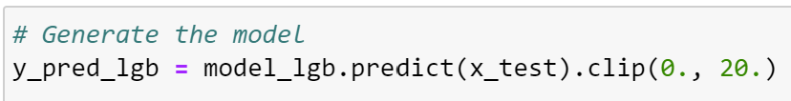
Model -2 : LGBM Regressor
We trained the model using the LGBM Regressor and the specified parameters.
We predicted by putting the first 80% of data as training data and rest 20% as testing data.
We later made the prediction using the test set

Slide 35
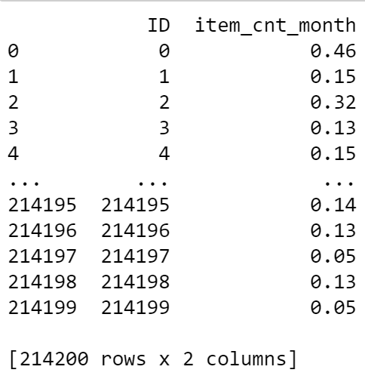
Model -2 : LGBM Regressor
We predicted the sales by making the LGBM of the testing dataset.
After predicting the sales, we saved the output in submissions using the item id and the its predicted sales.

Slide 36
Model Improvements
Prediction Model 2 has better outcome with rmse value as 0.45. The submission file had item counts with decimal value greater than 5 which was then rounded to 2digits after decimal.
The rsme value of the first model dropped from 0.8 to 0.43 by changing the max_depth parameters appropriately.
LightGBM Vs XGBoost
LightGBM is a great implementation that is similar to XGBoost but varies in a few specific ways, especially in how it creates the trees.
It offers some different parameters but most of them are very similar to their XGBoost counterparts.
If you use the same parameters, you almost always get a very close score. In most cases, the training will be 2-10 times faster though.

Slide 37
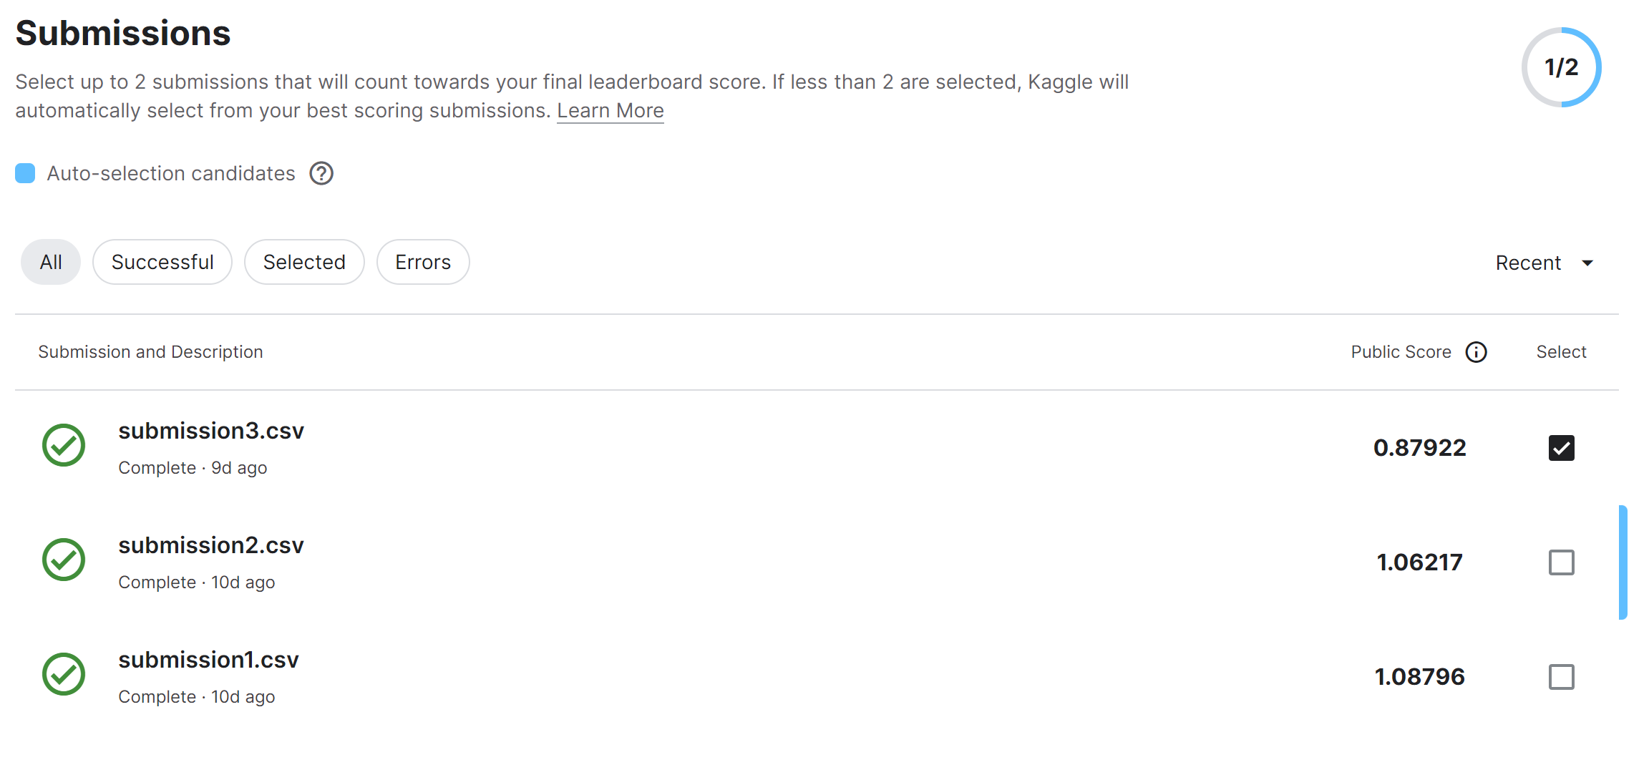
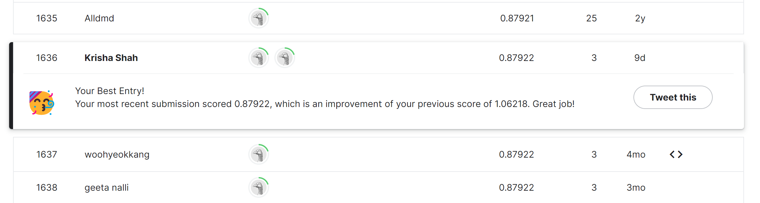
ranking
Submission 1 gives a public score of 1.06217 on Kaggle competition.
Submission 2 gives a public score of 0.87922 which leads to Rank 1636 on the leaderboard

Slide 38
Thank you
We are open for questions now !

